Slide 1
Project Management and Professional Ethics
Work Break down Structure(Managing Time and Activities phase)

Slide 2
Contents
How do you define WBS?
Work Breakdown Structure Properties.
Developing a WBS .
Types of WBS.
How to Make a Work Breakdown Structure.
Uses of WBS.

Slide 3
Work Breakdown Structure
Systems analysts are responsible for completing projects on time and within budget and for including the features promised.
In order to accomplish all three of these goals,often a project needs to be broken down into smaller tasks or activities; These tasks together make up a work breakdown structure (WBS)
For projects, the Work Breakdown Structure (WBS) is the tool that utilizes this technique and is one of the most important project management documents.

Slide 4
The Project Management Institute (PMI) Project Management Book of Knowledge (PMBOK) defines the Work Breakdown Structure as a “deliverable oriented hierarchical decomposition of the work to be executed by the project team.”

Slide 5
Work Breakdown Structure Properties
Each task or activity contains one deliverable, or tangible outcome, from the activity
Each task can be assigned to a single individual or a single group
Each task has a responsible person monitoring and controlling performance

Slide 6
Developing a WBS
Decomposition, starting with large ideas, then breaking them down into manageable activities
Product oriented, building a website can be broken down into many parts
Process-oriented, emphasizes the importance of each phase

Slide 7
Types of WBS
There are two types of WBS:
1) Deliverable-Based and 2) Phase-Based. The most common and preferred approach is the Deliverable-Based approach.
The main difference between the two approaches are the Elements identified in the first Level of the WBS.

Slide 8
Deliverable based work breakdown Structure
A Deliverable-Based Work Breakdown Structure clearly demonstrates the relationship between the project deliverables (i.e., products,services or results) and the scope (i.e., work to be executed).

Slide 9
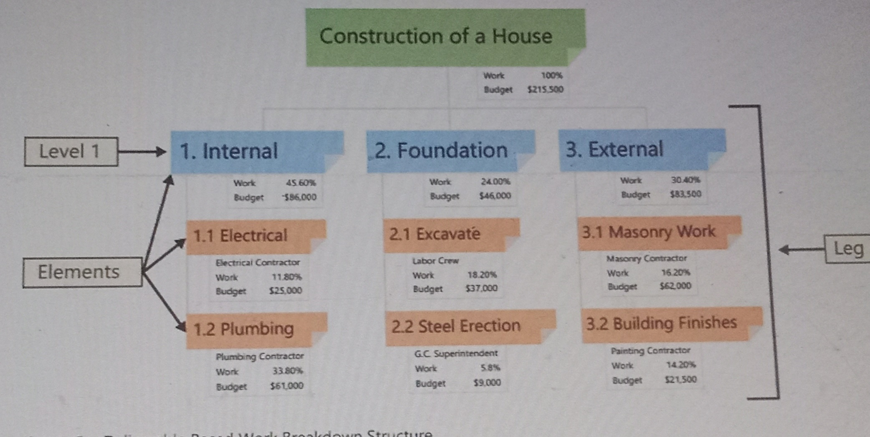
Figure 1 (Deliverable WBS)

Slide 10
In Figure 1, the Level 1 Elements are summary deliverable descriptions. The Level 2 Elements in each Leg of the WBS are all the unique deliverables required to create the respective Level 1 deliverable.

Slide 11
Phase-Based WBS
A Phase-Based WBS requires work associated with multiple elements be divided into the work unique to each Level.
In Figure 2, a Phase-Based WBS, the Level 1 has five Elements. Each of these Elements are typical phases of a project. The Level 2 Elements are the unique deliverables in each phase.

Slide 12
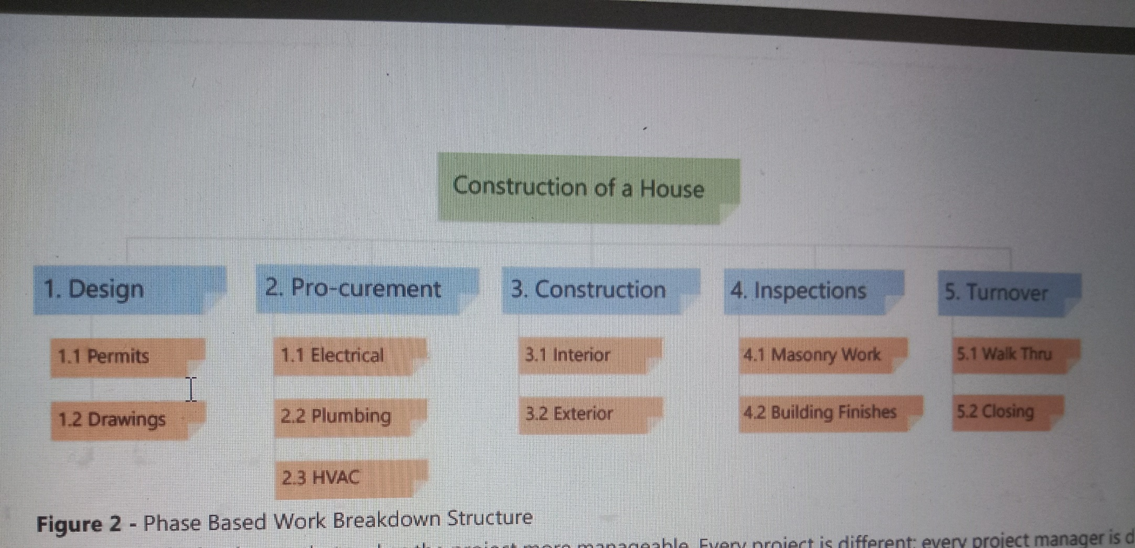
Figure 2: Phase based WBS

Slide 13
How to Make a Work Breakdown Structure
A good Work Breakdown Structure is created using an iterative process by following these steps and meeting these guidelines:
1. Gather Critical Documents
a. Gather critical project documents.
b. Identify content containing project deliverables, such as the Project Charter, Scope Statement and Project Management
Plan (PMP) subsidiary plans.
2. Identify Key Team Members
a. Identify the appropriate project team members.
b. Analyze the documents and identify the deliverables.

Slide 14
3. Define Level 1 Elements
a. Define the Level 1 Elements. Level 1 Elements are summary deliverable descriptions that must capture 100% of the project scope.
b. Verify 100% of scope is captured. This requirement is commonly referred to as the 100% Rule.
4. Decompose (Breakdown) Elements
a. Begin the process of breaking the Level 1 deliverables into unique lower Level deliverables. This “breaking down”technique is called Decomposition.
b. Continue breaking down the work until the work covered in each Element is managed by a single individual or organization. Ensure that all Elements are mutually exclusive.
c. Ask the question, would any additional decomposition make the project more manageable? If the answer is “no”, the WBS is done.

Slide 15
5. Create WBS Dictionary
a. Define the content of the WBS Dictionary. The WBS Dictionary is a narrative description of the work covered in each Element in the WBS. The lowest Level Elements in the WBS are called Work Packages.
b. Create the WBS Dictionary descriptions at the Work Package Level with detail enough to ensure that 100% of the project scope is covered. The descriptions should include information such as, boundaries, milestones, risks, owner, costs, etc.
6. Create Gantt Chart Schedule
a. Decompose the Work Packages to activities as appropriate.
b. Export or enter the Work Breakdown Structure into a Gantt chart for further scheduling and project tracking.

Slide 16
Uses of WBS
The Work Breakdown Structure is used for many different things.
1. Initially, it serves as a planning tool to help the project team plan,
define and organize scope with deliverables.
2.The WBS is also used as the primary source of schedule and cost estimate activities.
3. use as a description all of the work and as a monitoring and controlling tool.

